Slide 1
IMPORTANT
If you haven’t yet completed the task in which you measured your digit ratio and completed the BART task, then please stop reading
This set of slides contains details about the experiment that will ruin the results and make it hard for you to write a report

Slide 2
Data analysis
Measuring you risk-taking behaviour with the BART is a simple matter of measuring the average number of pumps you performed on the (non-bursting) balloons
In excel you need to create a column of data showing the number of pumps for each balloon, filtered by whether or not the balloon burst
The average of this column of filtered data is your BART measure of risk taking (higher scores mean higher willingness to risk popping the balloon)

Slide 3
Today’s study
You’ve been led to believe that you were studying the effects of testosterone on risk-taking behaviours
That isn’t exactly true (although it might be interesting too)
In reality today’s study is about the effects of experimenter bias and demand characteristics on subject’s responses
Demand characteristics are a problem when subjects know the aim of the study being conducted. There’s a strong tendency for subjects to try to conform to what they think the experimenter wants (their ‘demands’)

Slide 4
Measuring the effect of demand characteristics
How would you go about measuring such effects?
You could give people an expectation that they will be faster/slower/better… in condition A than condition B, and then measure their behaviour
But what if people genuinely are faster/slower/better in A than B? (the effect of demand characteristics are confounded with an actual change)
What you really need to do is give different groups different demand characteristics and measure the difference between the groups

Slide 5
Guess what we did today!
We created two different expectations about the results in the two groups.
Both groups were told that their digit ratios were quite high (we lied about the mean digit ratio being 0.85 – most of you will have a higher DR than that)
Group A were told that this implies a low testosterone level and a tendency to low-risk behaviours
Group B were told that this implies a high testosterone level and a tendency to high-risk behaviours
That is the only thing that differed between the groups (the experiment you ran was actually identical)

Slide 6
Your own demand characteristics
By measuring your digit ratio and knowing this ‘theory’ about its effects, you (hopefully) had some idea of what was ‘expected’ of you.
Did that effect your behaviour in the risk measurement?
Let’s explore some possible outcomes…

Slide 7
What effects might we see?
When told that your (supposedly high) DR predicts high/low BART scores, did you become more/less risky?
We could test for a difference between the groups in their BART scores
When told that a high DR implied high testosterone and, therefore more masculine traits, did it bias your measurement of your own DR?
We could look test whether there was a difference in average DR between groups
NB if some people consider themselves more masculine and others consider themselves more feminine, the bias effect might average to be zero?

Slide 8
Is there a genuine effect of digit ratio?
We could also look at the data for both groups (with their different expectations) and see if there really is an effect of digit ratio
We could plot the data from both groups in a clustered X-Y scatter plot (with colours specifying different groups). Do the data have similar patterns between groups?

Slide 9
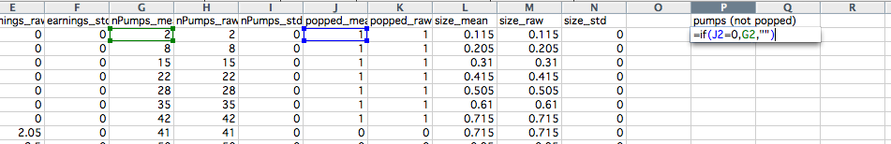
Analysing the data
Analysing the data for each individual is relatively easy:
Open your data file and filter out the balloons that were popped (the number of pumps for those tell us more about the balloons than about your behaviour!)
(Insert the formula =IF(J2=0,G2,“”) and then drag down)

Slide 10
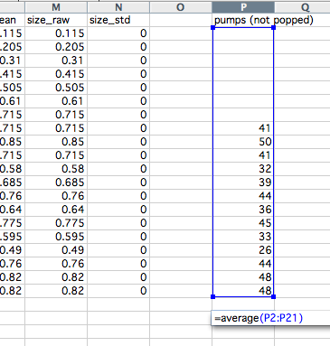
Analysing the data
… then take the average of number of pumps for these un-popped balloons:
This average is your risk-taking score (more pumps means happier to take risks).
Now we need to compare the risk-taking scores across subjects for the two groups

Slide 11
Analyses in SPSS
By now the demonstrators should have entered your group data into an SPSS data file for you to download
Based on your lecture in SPSS (stats Week 7?) conduct a t-tests comparing;
mean digit ratio between the groups
mean BART score between the groups
Do either show significant differences?
To plot the overall relationships between DR and BART;
select >Chart>ChartBuilder (see following slides)

Slide 12
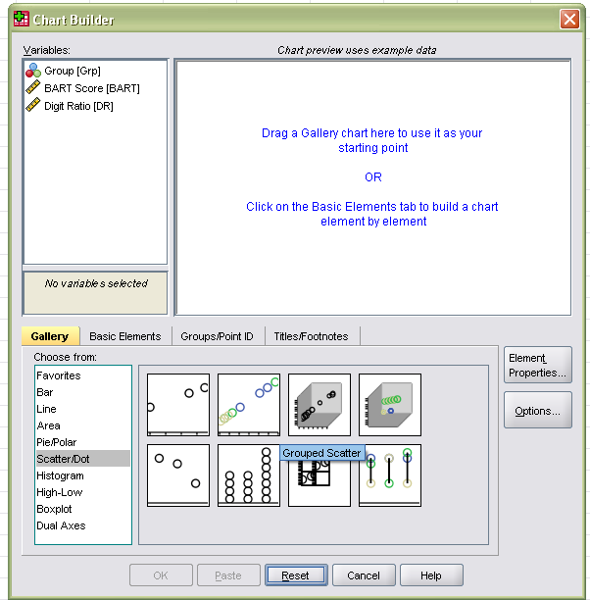
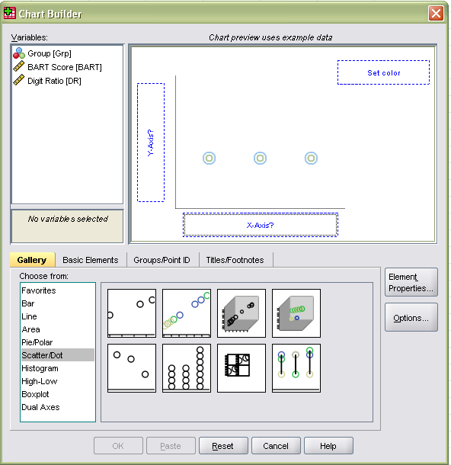
Create a scatter plot in chart builder
Drag variables to appropriate locations, then click OK

Slide 13
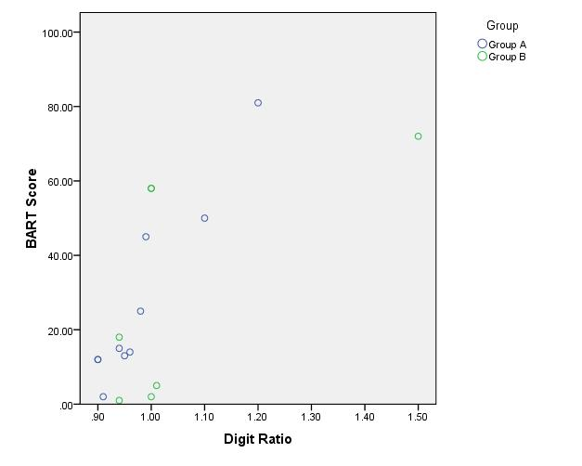
Adding a line of best fit
Double-click the graph in the OUTPUT window to edit it and add lines

Slide 14
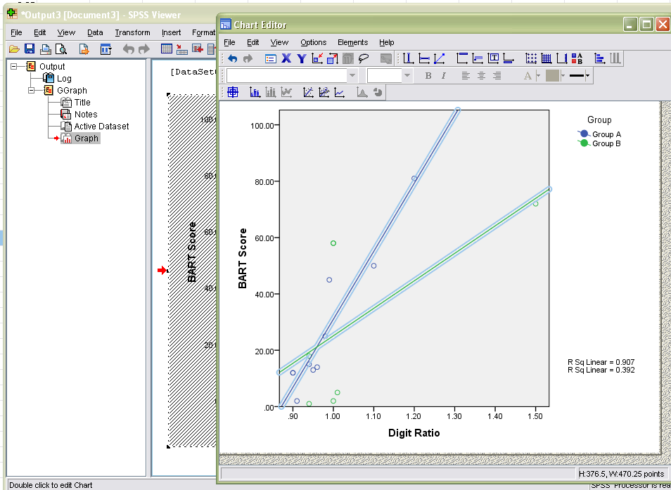
Adding a line of best fit
Once you have opened chart in the Chart Editor, click here
to add lines of best fit, then close the editor

Slide 15
Also, get the number of males and females for your methods section:
As before, get frequency of males and females with
>Analyze>DescriptiveStatistics>Frequencies
As before, get info about age range with
>Analyze>DescriptiveStatistics>Descriptives

Slide 16
Further experiment details
In this study the PsychoPy experiment is rather complex, with many Code Components to determine the size throughout the trial – don’t worry about trying to understand all that now!
But you should be able to see from the Excel spreadsheet that every balloon had a different ‘breakPoint’ (the size at which it would burst), varying from 0.1 (tiny) to 2.0 (the full size of the screen)
[Why does a size of 2.0 mean the whole screen? In the default units in PsychoPy the screen coordinates range from (-1,-1) bottom left to (+1,+1) for top right. A size of 2.0 will go from -1 to +1. Simple!]
In this study the size (in these ‘normalised’ units) at each point in time was calculated as: 0.1 + (nPumps x 0.015)

Slide 17
The real theories of digit ratio
In reality the average digit ratio for males is around 1.0 and for females is around 0.96
(hence, when we told you that it was 0.90 most of you ended up categorising yourself as ‘high’ DR)
In reality, the theory claims that a huge number of things (including sexuality, health, interests in clothes shopping…) are related to DR
But before you take them all very seriously, check each paper for demand characteristics and experimenter bias!

